Slide 1
Linear Regression Part II: Model Specification & Estimation
Dr. Upender Subramanian
MKT/BUAN 6337

Slide 2
Type of Explanatory Variables
Continuous variables (e.g., price, income, age)
Categorical / Indicator / Dummy variables (e.g., gender, product category, geographical territory, time-period)
Interaction variables: Product of two or more other independent variables

Slide 3
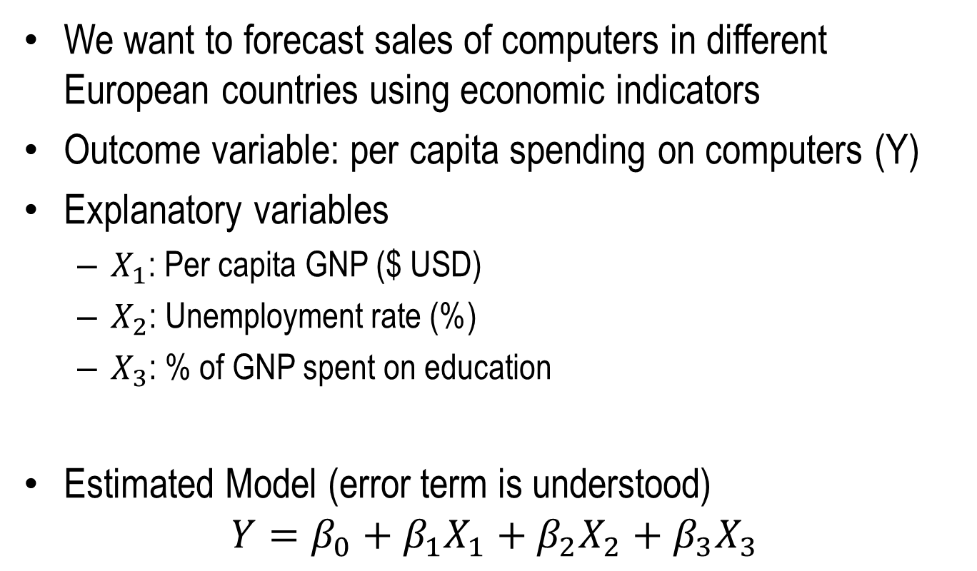
Example: Sales Forecasting
We want to forecast sales of computers in different European countries using economic indicators
Outcome variable: per capita spending on computers (Y)
Explanatory variables
$X_{1}$: Per capita GNP ($ USD)
$X_{2}$: Unemployment rate (%)
$X_{3}$: % of GNP spent on education
Estimated Model (error term is understood)
$$Y=β_{0}+β_{1}X_{1}+β_{2}X_{2}+β_{3}X_{3}$$

Slide 4
SAS Code
proc reg data = reg.computer_sales;
model spending_per_capita = gnp_per_capita
unemployment_rate
percentage_education_spend;
run;

Slide 5
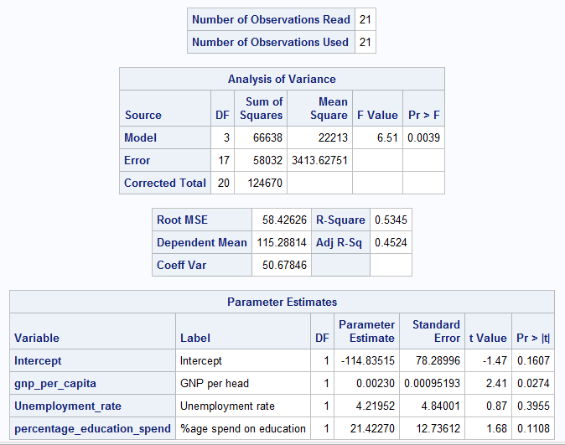
SAS Output

Slide 6
Interpreting the Results
Is the model statistically significant?
H0: ALL coefficients are zero (F-test)
How well does model explain the variation in the outcome?
Without a model, best we could do is use the average value of Y
How much better does the model do?
R-square = 0 => no better; R-square = 1 => perfectly explains all variation (relative to the average value of Y)

Slide 7
Interpreting the Results
NOTE: Use Adj. R-square to compare models with different number of variables
R-square can be misleading for comparison as a model with more variables will generally explain more variance even if it does not truly explain the relationship better
Adj. R-square penalizes a model with more variables
For the same R-square, a model with fewer variables will have higher Adj. R-square

Slide 8
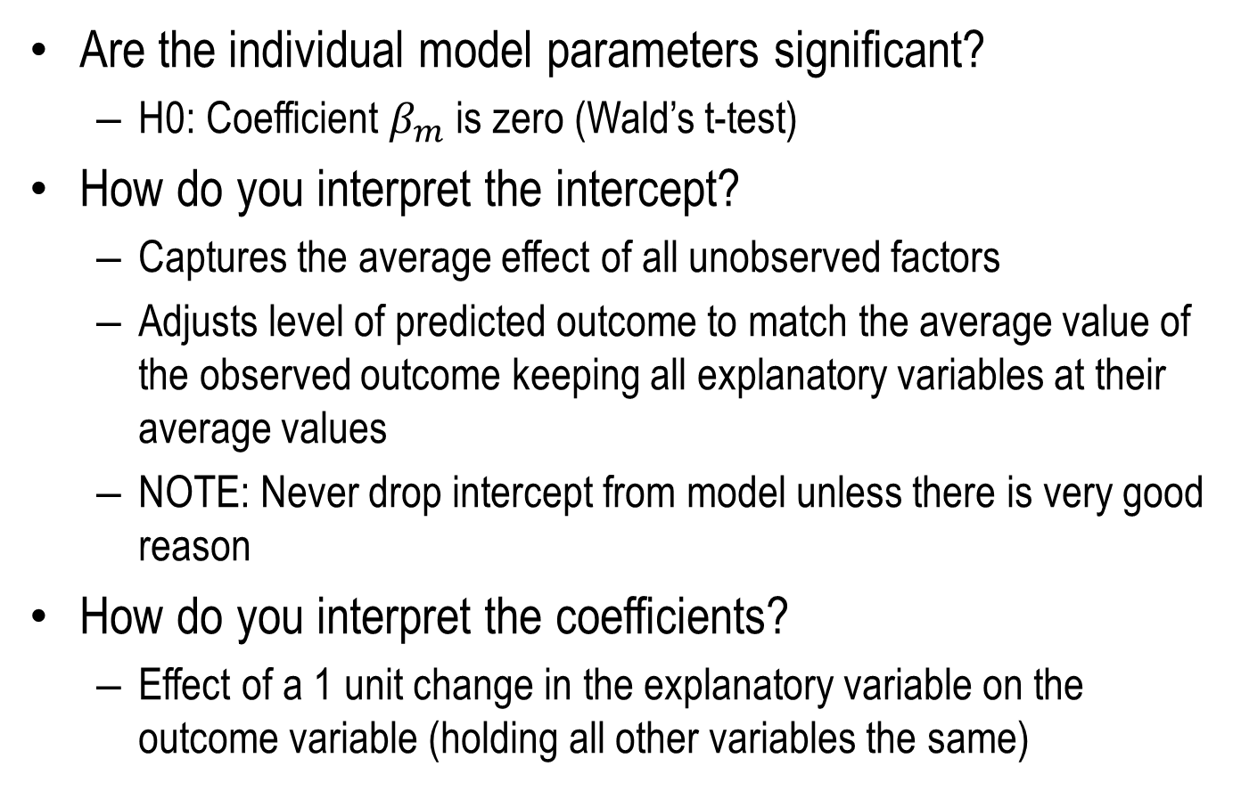
Interpreting the Results
Are the individual model parameters significant?
H0: Coefficient $β_{m}$ is zero (Wald’s t-test)
How do you interpret the intercept?
Captures the average effect of all unobserved factors
Adjusts level of predicted outcome to match the average value of the observed outcome keeping all explanatory variables at their average values
NOTE: Never drop intercept from model unless there is very good reason
How do you interpret the coefficients?
Effect of a 1 unit change in the explanatory variable on the outcome variable (holding all other variables the same)

Slide 9
Nominal Explanatory Variables
Example: Eastern or Western European Country
Why can incorporating this variable be useful?
Option 1: Analyze each subgroup separately
Estimate separate regression model for each group
Generates different slope, intercept for each group
Reduces the data available in each
Option 2: Analyze both subgroups together using indicator variable for subgroup
E.g., Define variable Eastern_Europe = 1, if in Eastern Europe
= 0, otherwise

Slide 10
Nominal Explanatory Variables
Indicator variable takes only two values: typically 0 and 1
Condition in which indicator variable is 0 is referred to as the base condition.
Coefficient of indicator variable represents the difference in outcome between being in the base condition and not being in the base condition.

Slide 11
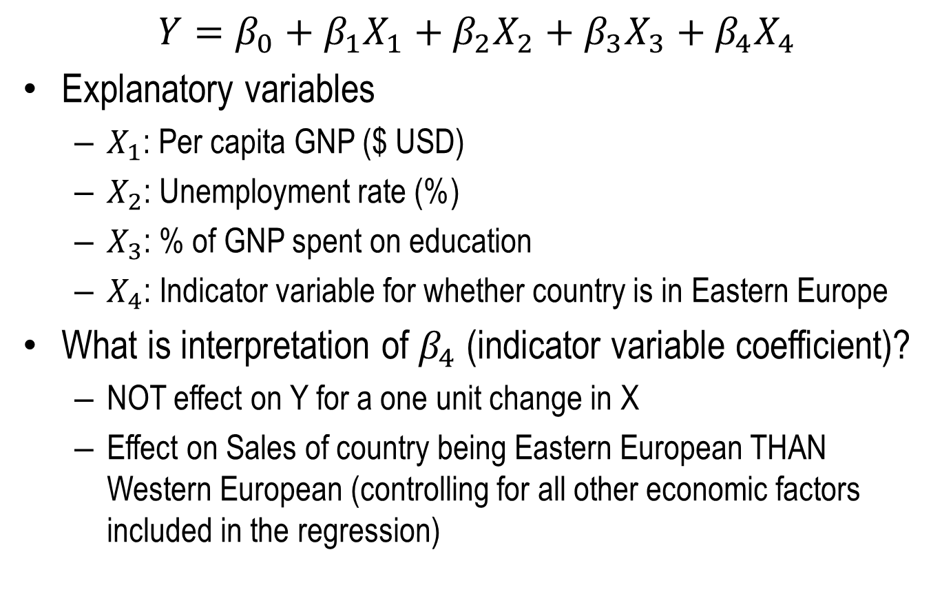
Nominal Explanatory Variables
$$Y=β_{0}+β_{1}X_{1}+β_{2}X_{2}+β_{3}X_{3}+β_{4}X_{4}$$
Explanatory variables
$X_{1}$: Per capita GNP ($ USD)
$X_{2}$: Unemployment rate (%)
$X_{3}$: % of GNP spent on education
$X_{4}$: Indicator variable for whether country is in Eastern Europe
What is interpretation of $β_{4}$ (indicator variable coefficient)?
NOT effect on Y for a one unit change in X
Effect on Sales of country being Eastern European THAN Western European (controlling for all other economic factors included in the regression)

Slide 12
Example: Shopper Data
MODEL
Units purchased = a+b₁*price paid + b₂*feature ad + b₃*display
Data

Slide 13
Multi-Category Indicator Variables
What if a nominal explanatory variable has more than 2 levels?
E.g., seasons in a year, territory or state, race
Cannot assign numbers 1, 2, 3, 4… because an indicator variable can only take on two values (0 and 1).
Instead use multiple indicator variables to represent (“code”) one multi-category variable.
If a categorical variable has d levels, then d-1 indicator variables are used to code this categorical variable.
Fix one category level as the base condition of all of the indicator variables are 0.

Slide 14
Example: Forecasting Car Sales
Data on car sales (1979-1986)
Dependent variable: Sales (in thousands of cars)
Independent Continuous Variables
LagGNP(in billion dollars)
LagUnemp (Unemployment Rate)
LagInterest(Interest Rate)
Where lag indicates values at end of previous quarter.
Independent Indicator Variables:
Q1 equals 1 if the quarter is 1,and 0 if otherwise
Q2 equals 1 if the quarter is 2,and 0 if otherwise.
Q3 equals 1 if the quarter is 3,and 0 if otherwise.
Why not have Q4?
Notes:
Why are we using Lag values ? - Because values for GNP, interest rate, and unemployment rate aren’t known at the beginning of the quarter.

Slide 15
SAS Code
proc reg data = reg.autos;
model Sales = Q1 Q2 Q3 lagGNP lagUnemp lagInt;
run;

Slide 16
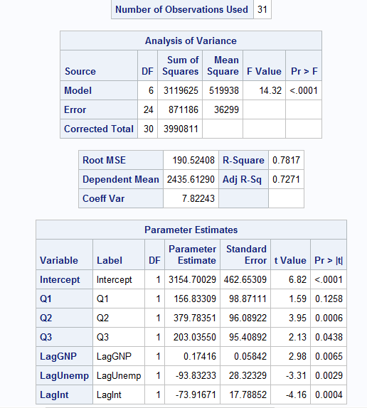
SAS Output
What is the interpretation of the intercept?
What do you infer from the coefficients?
How does sales in Q1, Q2 and Q3 compare with Q4?
What about Q1 and other quarters?
What does the effect of a quarter represent?
Which quarter(s) peaks at sales? What could be the reason?

Slide 17
Recoding Indicator Variables
What would happen to model estimates if we recode quarters using Q1 as the base level?
Omit Q1, Include Q2, Q3 and Q4 as indicator variables
Coefficients now represent difference in sales wrt Q1
Model is essentially the same except for recoding
Should provide same predictions as before
Predicted difference between quarters should be same as before
Notes:
Why are we using Lag values ? - Because values for GNP, interest rate, and unemployment rate aren’t known at the beginning of the quarter.

Slide 18
Recoding Indicator Variables
Notes:
Why are we using Lag values ? - Because values for GNP, interest rate, and unemployment rate aren’t known at the beginning of the quarter.

Slide 19
Recoding Indicator Variables
Notes:
Why are we using Lag values ? - Because values for GNP, interest rate, and unemployment rate aren’t known at the beginning of the quarter.

Slide 20
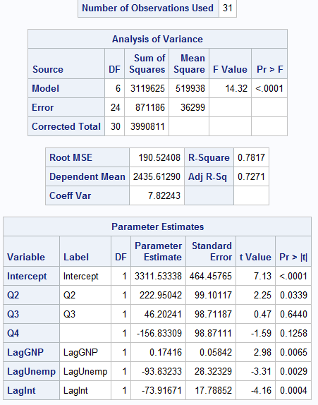
Recoded Model Results

